Slide 1
A Novel Parallel Search Technique for Optimization
Manaar Alam
Soumyajit Chatterjee
Haider Banka

Slide 2
Some existing meta-heuristic optimization algorithm
Genetic Algorithm: One of the most renowned meta-heuristic which is based on the Darwin’s theory of evolution, which imitates the process of natural selection and the natural phenomenon of survival of the fittest, in their artificial forms.
Particle Swarm Optimization: A meta-heuristic approach which works on the principle of social interaction and behaviour of particles in a swarm. It considers the experience obtained by the particle using self-introspection and by gaining experience from the social interaction within the flock.
Cuckoo Search: This also another kind of meta-heuristic algorithm which imitates the Brood Parasitism, shown by some species of Cuckoos, in its artificial form. Combined with the power of Lévy flights, Cuckoo search emerges as one of the strong meta-heuristics.

Slide 3
Motivation
Previous Meta-Heuristic optimization algorithms have some issues –
Tunable Parameter: These are a set of user-defined parameters required by the meta-heuristic algorithms to produce desirable results. E.g.: Crossover probability of GA, Inertial weight in PSO and New Nest probability in CS. But assigning proper values to these is itself a tough task.
Skipping of many points in the Search Space: These algorithms usually have a tendency to jump to new points and while performing so most of the times these algorithms leave an appreciable part of the search space unexplored.
Evaluation of duplicate points: The general approach followed by these algorithms pull towards a specific set of solutions, but while performing these, most of the times these algorithms evaluate the same set of solution points again and again.

Slide 4
Proposed technique
The proposed algorithm tries to eradicate the issues discussed in the previous slide.
First of all, this approach has a very few number of tunable parameters.
This approach introduces two of its niche operators named: Rotate Left and Complement (RLC) and Flip Operator.
The first operator is meant to explore the search space exhaustively, yet maintaining the virtue of parallelism. The second operator is meant to introduce variations in the solutions.
With these two parameters the algorithm increases its features of exploration and exploitation, while removing the backdrops of evaluating duplicate points repeatedly and leaving parts of search space completely untouched.

Slide 5
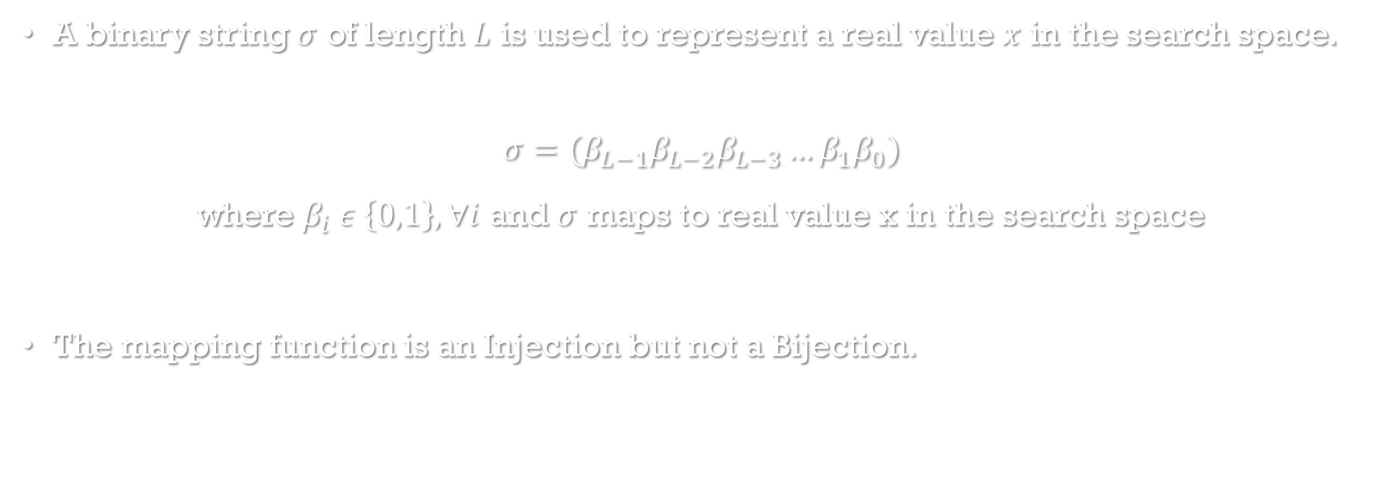
Representation of solution
A binary string $σ$ of length $L$ is used to represent a real value $x$ in the search space.
$$σ=(β_{L−1}β_{L−2}β_{L−3}…β_{1}β_{0})$$
where $β_{i} ε \left\{0,1\right\}, ∀i$ and $σ$ maps to real value x in the search space
The mapping function is an Injection but not a Bijection.

Slide 6

Operators used
Rotate Left Complement (RLC)
Used for Generating distinct solution points.
For a binary string of length $L$ fetch the most significant bit, i.e., $β_{L−1}$, rotate the string to the left and put the complement of $β_{L−1}$, i.e., ${\overline{β}}_{L−1}$, in the least significant position.
0
1
1
1
1
1
1
1
0
1
0
0
0
0
0
0
0
1

Slide 7
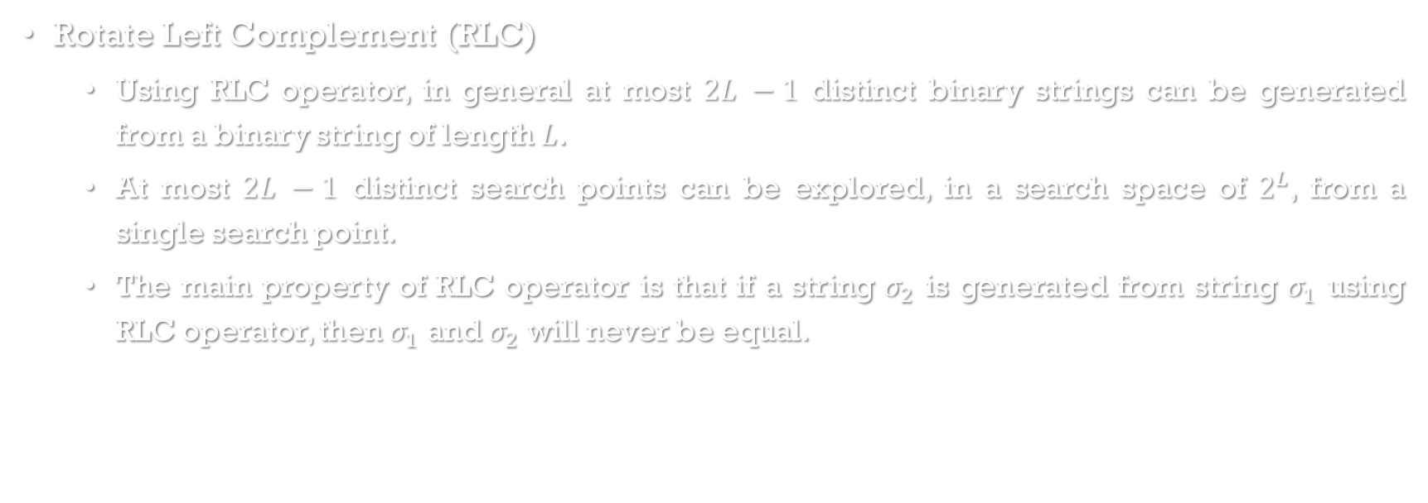
Operators used
Rotate Left Complement (RLC)
Using RLC operator, in general at most $2L −1$ distinct binary strings can be generated from a binary string of length $L$.
At most $2L −1$ distinct search points can be explored, in a search space of $2^{L}$, from a single search point.
The main property of RLC operator is that if a string $σ_{2}$ is generated from string $σ_{1}$ using RLC operator, then $σ_{1}$ and $σ_{2}$ will never be equal.

Slide 8
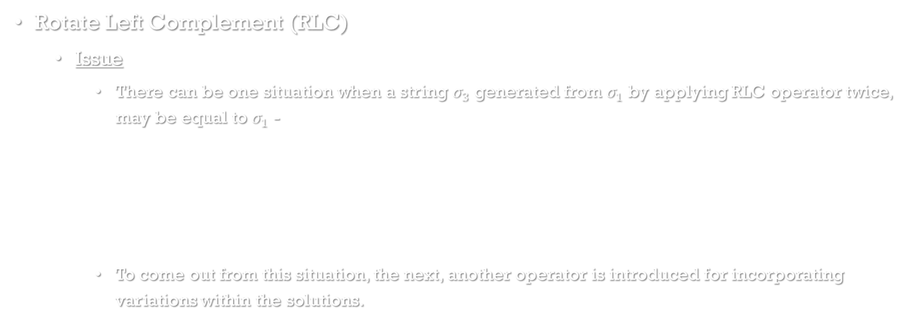
Operators used
Rotate Left Complement (RLC)
Issue
There can be one situation when a string $σ_{3}$ generated from $σ_{1}$ by applying RLC operator twice, may be equal to $σ_{1}$ -
To come out from this situation, the next, another operator is introduced for incorporating variations within the solutions.
1
0
1
0
1
0
Duplicate
1
0
1

Slide 9

Operators used
Flip Operator
Incorporates more variation within the solutions.
For a binary string of length $L$ replace each $β_{i}$ by its complement, i.e., $\overline{β_{i}}$, one by one to generate $L$ distinct binary strings.
This operator provides $L$ new binary strings of length $L$ from the old string.
1
0
1
0
0
1
1
1
1
1
0
0

Slide 10
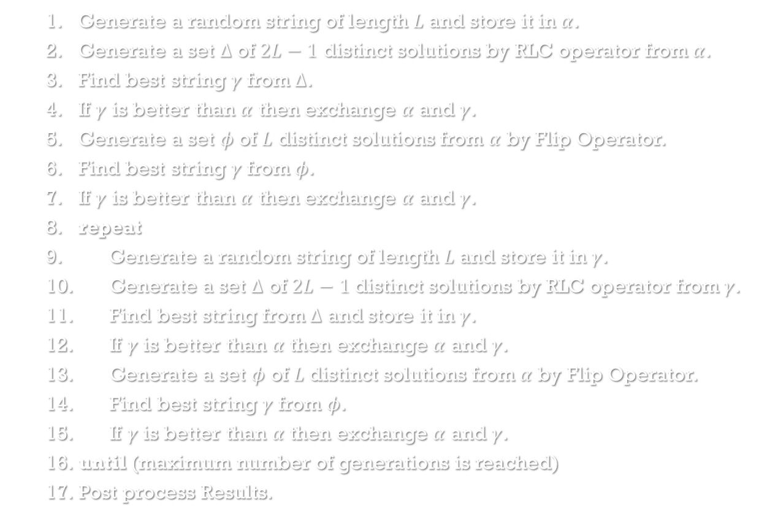
Algorithm
Generate a random string of length $L$ and store it in $α$.
Generate a set $Δ$ of $2L−1$ distinct solutions by RLC operator from $α$.
Find best string $γ$ from $Δ$.
If $γ$ is better than $α$ then exchange $α$ and $γ$.
Generate a set $φ$ of $L$ distinct solutions from $α$ by Flip Operator.
Find best string $γ$ from $φ$.
If $γ$ is better than $α$ then exchange $α$ and $γ$.
repeat
Generate a random string of length $L$ and store it in $γ$.
Generate a set $Δ$ of $2L−1$ distinct solutions by RLC operator from $γ$.
Find best string from $Δ$ and store it in $γ$.
If $γ$ is better than $α$ then exchange $α$ and $γ$.
Generate a set $φ$ of $L$ distinct solutions from $α$ by Flip Operator.
Find best string $γ$ from $φ$.
If $γ$ is better than $α$ then exchange $α$ and $γ$.
until (maximum number of generations is reached)
Post process Results.

Slide 11
Results and analysis
This algorithm is compared with different meta-heuristic algorithms mentioned previously such as Genetic Algorithm, Particle Swarm Optimization and Cuckoo Search for a single objective optimization benchmark functions. The analysis is shown in the following tables.
Table 1 : Shows different uni-modal benchmark functions used for analysis with their optimal values
for different meta-heuristic algorithms.
Table 2 : Shows the approximate number of iteration each algorithm takes to converge to the optimal
solution for the uni-modal functions.
Table 3 : Shows different multi-modal benchmark functions used for analysis with their optimal values
for different meta-heuristic algorithms.
Table 4 : Shows the approximate number of iteration each algorithm takes to converge to the optimal
solution for the multi-modal functions.

Slide 12
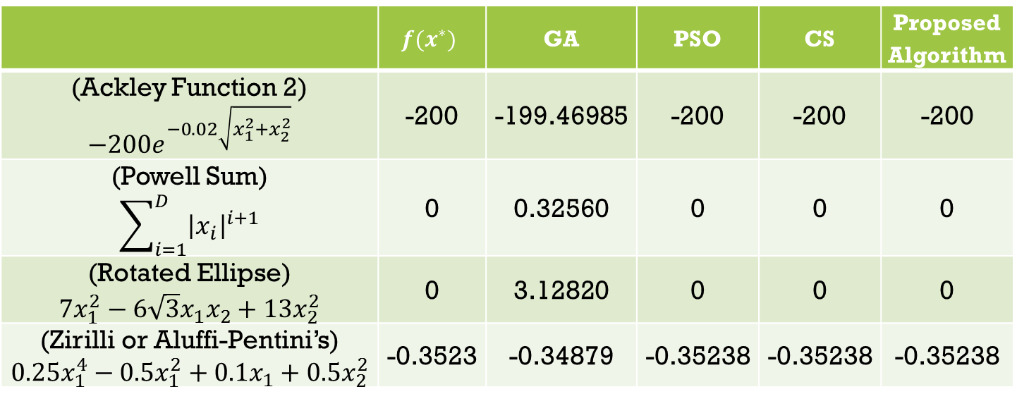
Results and analysis
 | $$f(x^{∗})$$ | GA | PSO | CS | Proposed Algorithm
(Ackley Function 2) $$−200e^{−0.02\sqrt{x_{1}^{2}+x_{2}^{2}}}$$ | -200 | -199.46985 | -200 | -200 | -200
(Powell Sum) $$\sum_{i=1}^{D}{{\left|x_{i}\right|}^{i+1}}$$ | 0 | 0.32560 | 0 | 0 | 0
(Rotated Ellipse) $$7x_{1}^{2}−6\sqrt{3}x_{1}x_{2}+13x_{2}^{2}$$ | 0 | 3.12820 | 0 | 0 | 0
(Zirilli or Aluffi-Pentini’s) $$0.25x_{1}^{4}−0.5x_{1}^{2}+0.1x_{1}+0.5x_{2}^{2}$$ | -0.3523 | -0.34879 | -0.35238 | -0.35238 | -0.35238
Table 1 : Analysis for Uni-Modal Functions

Slide 13
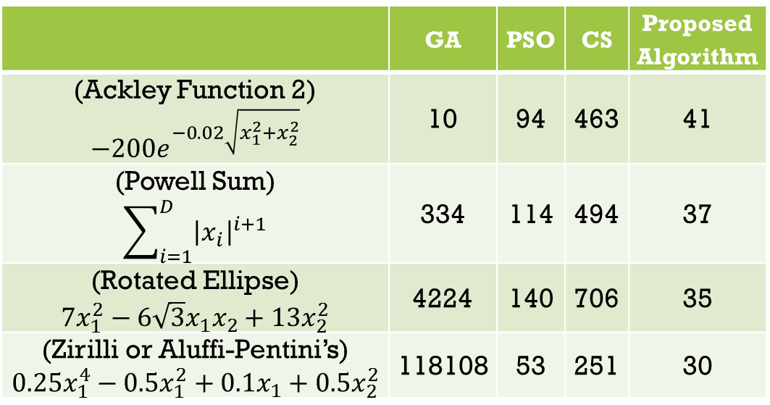
Results and analysis
 | GA | PSO | CS | Proposed Algorithm
(Ackley Function 2) $$−200e^{−0.02\sqrt{x_{1}^{2}+x_{2}^{2}}}$$ | 10 | 94 | 463 | 41
(Powell Sum) $$\sum_{i=1}^{D}{{\left|x_{i}\right|}^{i+1}}$$ | 334 | 114 | 494 | 37
(Rotated Ellipse) $$7x_{1}^{2}−6\sqrt{3}x_{1}x_{2}+13x_{2}^{2}$$ | 4224 | 140 | 706 | 35
(Zirilli or Aluffi-Pentini’s) $$0.25x_{1}^{4}−0.5x_{1}^{2}+0.1x_{1}+0.5x_{2}^{2}$$ | 118108 | 53 | 251 | 30
Table 2 : Approximate Number of Iterations

Slide 14
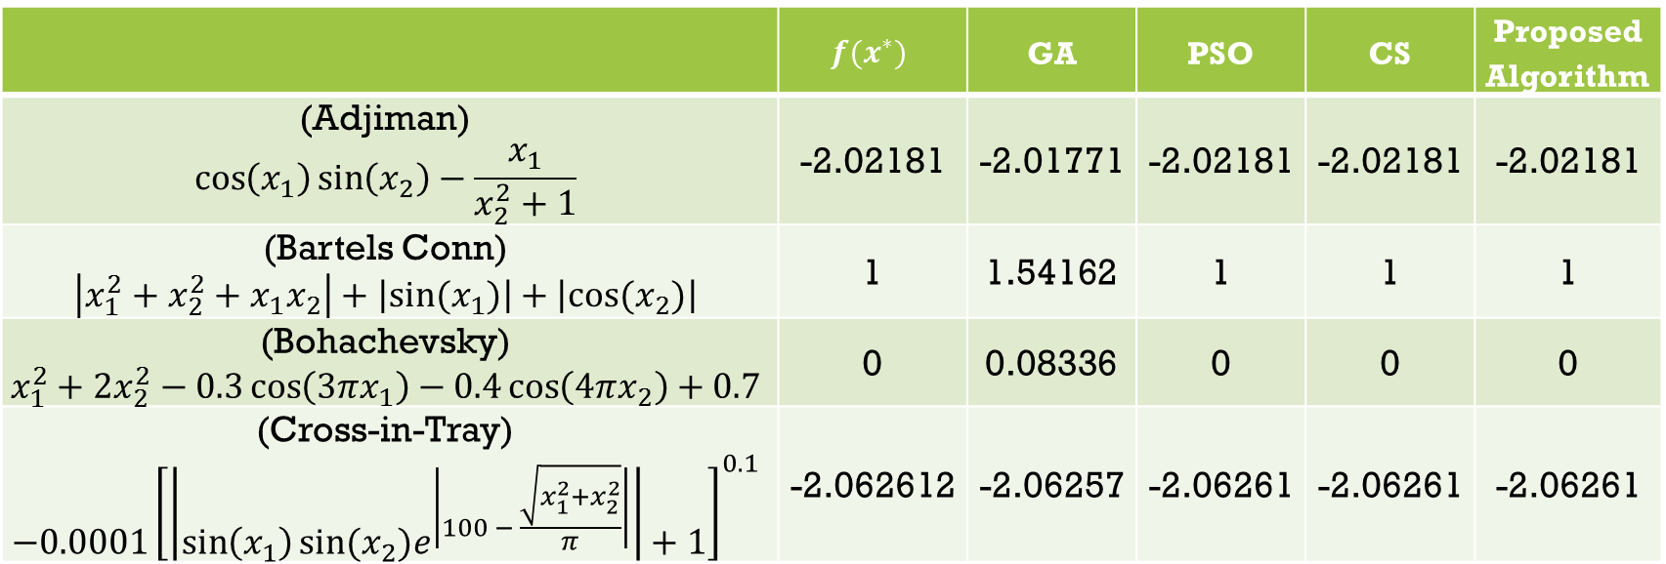
Results and analysis
 | $$f(x^{∗})$$ | GA | PSO | CS | Proposed Algorithm
(Adjiman) $$\cos\left(x_{1}\right)\sin\left(x_{2}\right)−\frac{x_{1}}{x_{2}^{2}+1}$$ | -2.02181 | -2.01771 | -2.02181 | -2.02181 | -2.02181
(Bartels Conn) $$\left|x_{1}^{2}+x_{2}^{2}+x_{1}x_{2}\right|+\left|sin⁡(x_{1})\right|+\left|cos⁡(x_{2})\right|$$ | 1 | 1.54162 | 1 | 1 | 1
(Bohachevsky) $$x_{1}^{2}+2x_{2}^{2}−0.3\cos\left(3πx_{1}\right)−0.4\cos\left(4πx_{2}\right)+0.7$$ | 0 | 0.08336 | 0 | 0 | 0
(Cross-in-Tray) $$−0.0001{\left[\left|\sin\left(x_{1}\right)sin⁡(x_{2})e^{\left|100 − \frac{\sqrt{x_{1}^{2}+x_{2}^{2}}}{π}\right|}\right|+1\right]}^{0.1}$$ | -2.062612 | -2.06257 | -2.06261 | -2.06261 | -2.06261
Table 3 : Analysis for Multi-Modal Functions

Slide 15
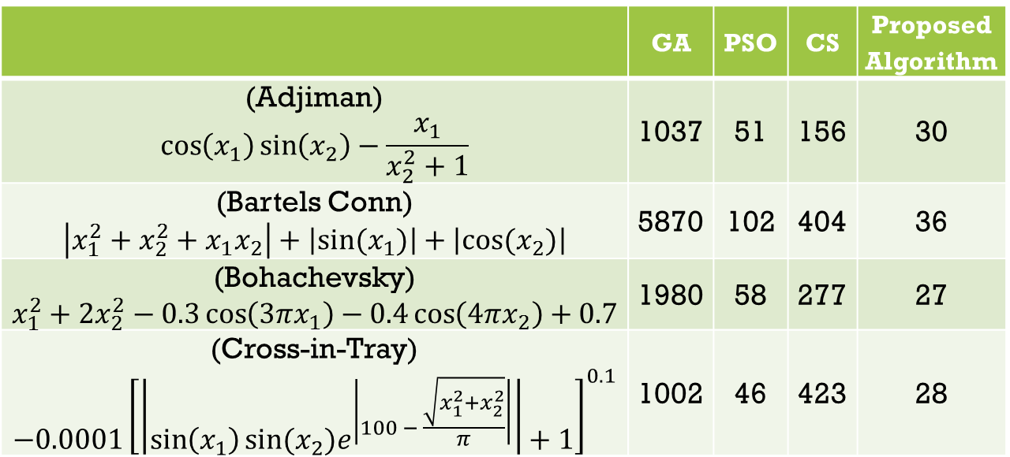
Results and analysis
 | GA | PSO | CS | Proposed Algorithm
(Adjiman) $$\cos\left(x_{1}\right)\sin\left(x_{2}\right)−\frac{x_{1}}{x_{2}^{2}+1}$$ | 1037 | 51 | 156 | 30
(Bartels Conn) $$\left|x_{1}^{2}+x_{2}^{2}+x_{1}x_{2}\right|+\left|sin⁡(x_{1})\right|+\left|cos⁡(x_{2})\right|$$ | 5870 | 102 | 404 | 36
(Bohachevsky) $$x_{1}^{2}+2x_{2}^{2}−0.3\cos\left(3πx_{1}\right)−0.4\cos\left(4πx_{2}\right)+0.7$$ | 1980 | 58 | 277 | 27
(Cross-in-Tray) $$−0.0001{\left[\left|\sin\left(x_{1}\right)sin⁡(x_{2})e^{\left|100 − \frac{\sqrt{x_{1}^{2}+x_{2}^{2}}}{π}\right|}\right|+1\right]}^{0.1}$$ | 1002 | 46 | 423 | 28
Table 4 : Approximate Number of Iterations

Slide 16
Conclusion
The results depict and prove that this algorithm quickly converges as it avoids repeated evaluations of duplicate points.
The precision of results show that the algorithm produces better results as it tries to search the search space exhaustively in parallel fashion.

Slide 17
Acknowledgement
The authors are thankful to Prof. C. A. Murthy, Indian Statistical Institute, Kolkata for his valuable contributions towards the paper.

Slide 18
references
[1] Goldberg, D.E., Genetic Algorithms, Pearson Education, 2006.
[2] Russell Eberhart, James Kennedy, A New Optimizer Using Particle Swarm Theory, 1995.
[3] Xin-She Yang and Suash Deb, Cuckoo Search via L´evy Flights, In Proceedings of World Congress on
Nature and Biologically Inspired Computing (NaBIC 2009), India, IEEE Publications, USA, pp 210-214
2009.
[4] B. Brey, Intel microprocessors : 8086/8088,80186,80286,80386, and 80486 architecture, programming,
and interfacing., New Delhi: Prentice Hall, 1995.
[5] Momin Jamil and Xin-She Yang, A literature survey of benchmark functions for global optimisation
problems, Int. J. Mathematical Modelling and Numerical Optimisation, Vol. 4, No. 2, 2013.
[6] Xin-She Yang, Nature-Inspired Optimization Algorithms, Elsevier, First Edition, 2014.
[7] S.N. Sivanandam and S.N. Deepa, Introduction to Genetic Algorithms, Springer, 2008.
[8] Kwang Y. Lee and Jong-Bae Park, Application of Particle Swarm Optimization to Economic Dispatch
Problem: Advantages and Disadvantages, IEEE, 2006.
[9] Riccardo Poli, Analysis of the Publications on the Applications of Particle Swarm Optimization, Journal of
Artificial Evolution and Applications, Vol. 2008, Article No. 3, Jan 2008.
[10] Xin-She Yang, Cuckoo Search and Firefly Algorithm: Theory and Applications, Springer, 2014.
[11] S. Walton, O.Hassan, K. Morgan and M.R. Brown Modified cuckoo search: A new gradient free
optimisation algorithm, Chaos, Solitons and Fractals, Elsevier, Vol. 44, Issue 9, pp- 710-718 Sept. 2011.

Slide 19
Thank You

